Slide 1
Strengthen Your Leadership Understanding the Clerk’s Key Roles & Responsibilities
Adam Keppel-Green FSLCC
April 2026

Slide 2
Do we all agree…
Every Clerk is
a Leader

Slide 3
Manager vs Leader
Management
is about doing things right
Leadership
is about doing the right things
(Peter Drucker)

Slide 4
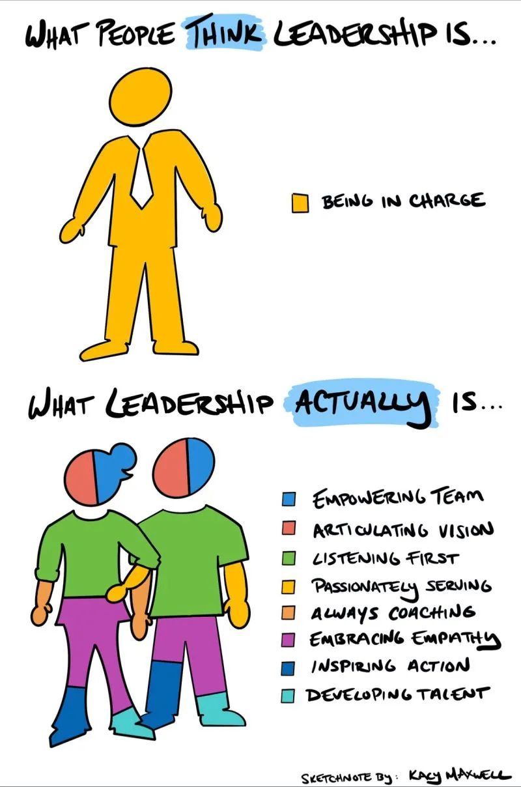
Manager vs Leader

Slide 5
Manager vs Leader

Slide 6

Manager vs Leader

Slide 7
We should all now agree…
Every Clerk is
a Leader

Slide 8
Technical Competence
What we do has to be underpinned by technical competence
  Understanding and applying the legislative framework
  Seeking out best practice
  Providing impartial accurate advice and guidance
Notes:
This is the specific value our role is designed to add.
This is where we differ from the amateur councillor.

Slide 9
Uphold the Constitution
We’re the guardian of the constitution
  Law is non-negotiable
  Understand and consistently apply policy and process
  Promote and embody Civility and Respect
  Know when (and how) to say no.
Notes:
Assertiveness

Slide 10
Have a plan
We plan for the future
  Help the council determine what its strategic priorities are
  Identify and plan for future challenges
  Get the council into the right position

Slide 11
Developing the team
We work to develop the whole team
  Ensure staff are committed, driven and empowered
  Provide support to councillors to fulfil their roles
  Build networks in the community and more widely
  Foster community engagement and develop future leaders
Notes:
Delegation, upskilling
Understanding your councillors. Their mandates, their drive.

Slide 12
Enablers
We enable positive action
  Our role is to turn ideas into action
  Horizon scanning and looking for opportunity
  Should be regarded as a helper not a hinderer
Notes:
Respect for the councillor’s democratic right to make decisions

Slide 13
Professional Standards
We’re resilient and open to challenge
  Expect, promote and welcome challenge
  Understand what supports your resilience
  Maintain professional boundaries
  Respect the role of the councillor
Notes:
This is that our standards are so high they stand up to scrutiny
Sometimes we just need to re-explain, add more detail
Understand difference in challenge of process and challenge of you.
Friendly not friend.
Digital boundaries

Slide 14
Thank you
Questions?

